Slide 1
Tumor-specific B-Cell Receptor Motif Discovery Using the DeepBCR Framework
Cynthia Chen
Mentor: Sherlock Hu
9/24/18 Liu Lab Meeting

Slide 2
Presentation Overview
Background: The DeepBCR project
Methods and Results: Identifying the CDR3 binding motifs for specific tumor antigens (aka: What did the model learn from the data?)
Model validation using synthetic data
Generating sequence logos to visualize CDR3 binding motifs
Compare models using feature correlation
Determine CDR3 binding location
Conclusion
Notes:
DeepBCR: project led by Sherlock
My project is a subsection – I’ll be focusing on this
Goal of my project: modelling behavior between B-cell R and antigen by identifying motifs on CDR3
List of general methods for my project
End by conclusion of what we found, applications, + what I plan to do in the future

Slide 3
The DeepBCR Project
Input data:
TCGA Data
(CDR3s extracted with TRUST)
DeepBCRNN Model
Output prediction:
Tumor-specific association scores
CDR3 Motif Extraction
Motif Extraction:
Validation Tests:
Sequence logo visualization
Positive control using synthetic data
Clustering
Determining binding location
Model comparison
Notes:
Workflow
Centered around DeepBCR model, neural network that takes in TCGA data formatted into CDR3s and outputs an array of association scores for 13 different tumor labels
My project is focused on using the output of the neural network to extract common CDR3 motifs for each tumor type
Employed variety of methods

Slide 4
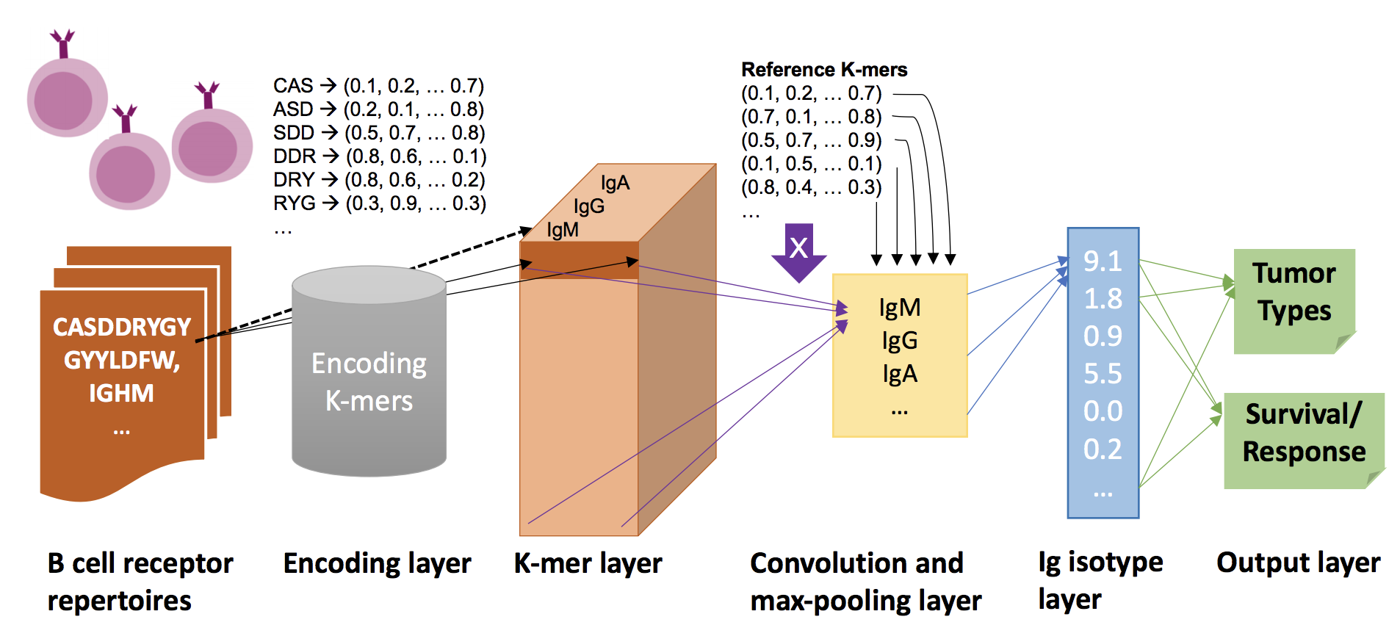
DeepBCR model framework (Sherlock Hu)
Notes:
Created by Sherlock
Multilayer neural network
Input: CDR3s in 4D binary array format
Many layers
Output: TUMOR TYPE ASSOCIATIONS
Binding scores for the 13 tumor types

Slide 5

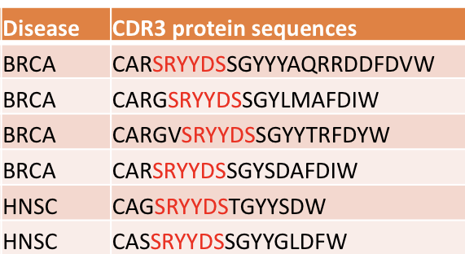
Input: Binary encoded CDR3s
TCGA cancer data (BCR repertoires)
12 relevant tumor types (+ normal tissue)
TRUST algorithm extracts CDR3s (Bo Li)
Binary encoding of CDR3s
CDR3 -> 6-mers -> 2D binary array
4D input array: 1) # patients; 2) # k-mers per patient; 3) k-mer length; 4) 20 (# of amino acid letters)
CARWYV
[0, 0, 1, . . . 0, 0]
[1, 0, 0, . . . 0, 0]
[0, . . . 1 . . . , 0]
[0, 0, . . . 1, 0, 0]
[0, 0, . . . 0, 1, 0]
[0, 0, . . . 0, 0, 1]
Output: Tumor-type association scores
Prediction of association with each of the 12 tumor types (or normal tissue)
Ex: [0.05, 0.05, 0.1, 0, 0, . . . , 0.6, 0.2]
4D binary input array containing all 6-mers for all patients
Notes:
Especially like to focus on input / output, since I wasn’t involved in the making of DeepBCR
TCGA raw data -> CDR3 using TRUST (liu lab)
CDR3 -> 6-mer
Each 6-mer is represented through a 2D binary array as shown
Output: array

Slide 6
Good performance… but what did the DeepBCR model learn?
Neural net = “Black Box”
AUC
Prediction Accuracy
*Random predictor will have an accuracy 7.7% and AUC=0.5
Notes:
Average AUC of 0.8 among all tumor types, 0.25
*Random predictor will have an accuracy 7.7% and AUC=0.5
Model performs clearly above the benchmark
Connection between my project + rest of the DeepBCR project
DeepBCR model must have picked up on some genetic patterns within the TCGA
However, neural network = mysterious black box
AI / ML
Goal of my project: patterns and trends that DeepBCR learned
Concludes the end of the DeepBCR background

Slide 7
Identifying Tumor-Specific CDR3 Binding Motifs Using the DeepBCR Framework
Question: How does our immune system recognize tumor cells?
Notes:
Modelling the interaction between B-cell receptors and antigens
Ultimate Question we wanted to answer: How does our immune system recognize tumor cells
Model interaction between BCR and antigen
We hypothesized that there is a set of BCR motifs that are associated with each tumor-type

Slide 8
Goal: Identify CDR3 binding motifs for specific tumor antigens
Specifically focus on CDR3
Tumor-specificity
Methods:
NN model validation using synthetic data
Generating tumor-specific sequence logos for motif visualization
Comparison of models using feature correlation
Identifying the CDR3 binding location
Notes:
Specific goal
CDR3 – diverse, known from previous studies to be a region that is very important for determining tumor specificity / Previous studies have shown that the CDR3 is highly diverse region that is especially important to tumor-specificity
Hypothesize Each tumor-type has specific antigens that are recognized by different BCR motifs
4 Stages

Slide 9
1. Validating NN model performance using synthetic data
Notes:
Positive control experiment –
Goal: to see whether the neural net is learning the correct motifs (aka: can it identify the positive kmers embedded in the data)
Reason for synthetic:
With real data, we don’t know whether the motif we identify is correct
When creating synthetic data, we can modify the data so that there are “embedded motifs”, don’t tell the neural network

Slide 10
Methods: Synthetic Data
Generate synthetic data
Train model
Testing: feed random kmers
Select top 5% of kmers
Create sequence logo
Training
Generate random synthetic data (4D binary array)
Embedding “positive” k-mers
Data with positive k-mer = cancer (1)
Data without positive k-mer = no cancer (0)
Train NN model on synthetic data
Testing
Feed random input k-mers into trained model
Output: Prediction scores (0 -> 1)
Greedy clustering on top-kmer
Sequence logos using only top-scoring k-mers
PWM calculation -> motifStack
Notes:
2 parts:
Generate synthetic data
Decided what positive kmer is
Positive kmer = BCR sequence that can bind to any cancer antigen
”Embedding positive kmers” means that input with positive kmer = 1, without = 0 (not tumor type specific!)
Training model - NOT USING the actual DEEPBCR, just a normal neural network
Testing:
Feed the 4d binary array
Get an probability output that resembled how likely the kmer was to be a “positive kmer”
Took the top 5% scoring of kmers
Clustered on these kmers : EXPLAIN: greedy method (took 1st kmer, found similar ones and made a cluster, and continued this process on the remaining kmers)
Generated sequence logos (results on next slide)

Slide 11
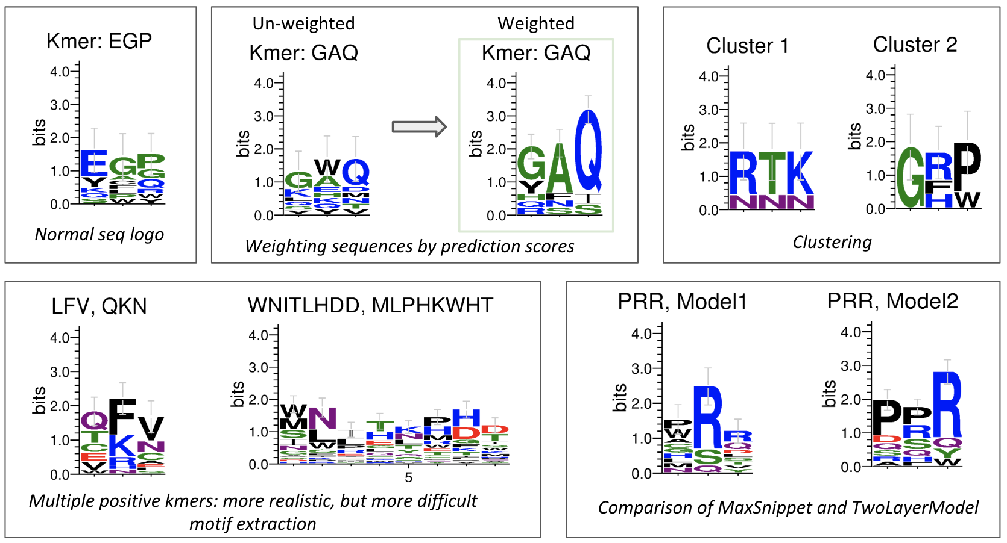
Results: Sequence logos reveal embedded positive k-mers
Kmer: RTK, GRP
Notes:
1st) GOOD RESULTS - METHODS VALIDATED, concluded neural network definitely able to pick up on the “embedded kmer”
Weighting helps emphasize the results (kmer with score of 0.8 should be weighted more than a kmer with 0.5 even tho they’re both in the top 5%)
CLUSTERING: identifying multiple positive kmers greedy clustering, real life: there isn’t just one BCR sequence that can bind to an antigen, so we accounted for this -> shows how models can pick up on multiple embedded positive kmers
Longer sequences (6-mers) more realistic binding length, but harder for model to pick up on, more noise
Model comparison: similar performance but slightly different

Slide 12
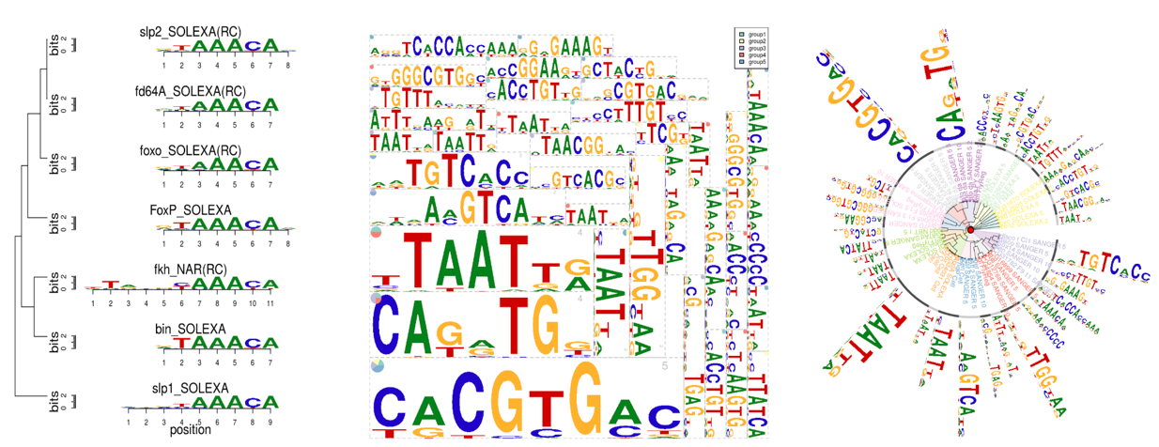
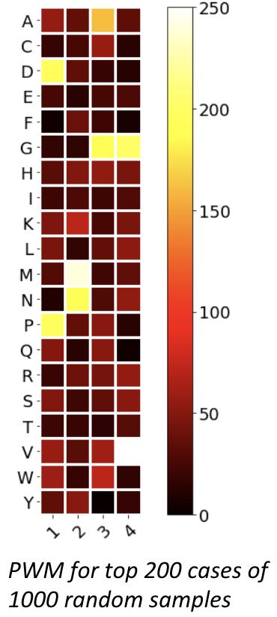
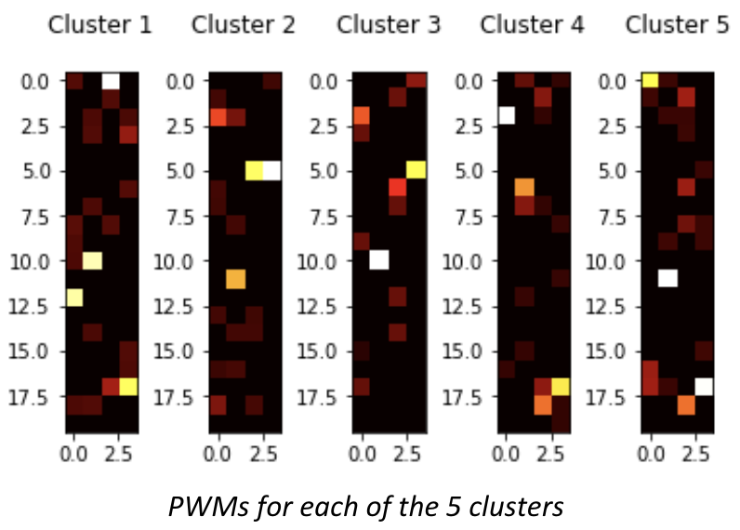
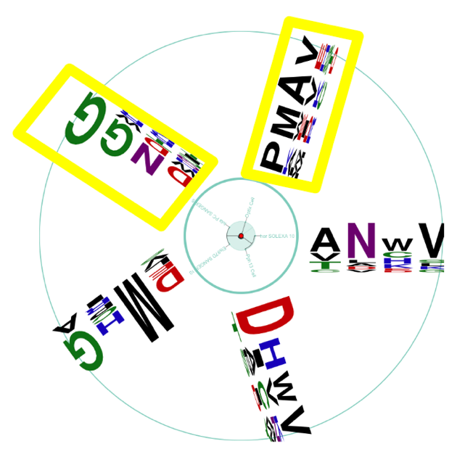
motifStack package for visualizing multiple sequence logos
(Jianhong Ou, et al.)
Functionality
Disadvantages
Revising the package: source code modifications
Example: Positive kmers - DNGG, PMAV
Radial sequence logo
Notes:
Functionality:
Complex, customizable sequence logo graphics that can help elucidate patterns within motif data
Input: PWM
Can produce single motif, stack, Tree, Cloud format, Radial Phylog
Disadvantages
Only for DNA (4 letters) and not for amino acids (20 letters)
This causes many problems, the most important of which is finding the ”distance” between 2 motifs for clustering
Source code modifications
Thus, we had to go into the package’s source code and modify the code so that it could be compatible with amino acids
Conclude through syn data analyses that simple NN is able to pick up on embedded kmer data

Slide 13
2. Identifying tumor-specific binding motifs using DeepBCR
Synthetic data -> TCGA data
Simple NN -> DeepBCR
2 classes -> Tumor-type specific
Notes:
Main part of my project
3 diff:
-TCGA data for training
- DeepBCR
TUMOR-TYPE SPECIFIC
Sequence logos
Clustering

Slide 14
Methods
CDR3 sequences -> 4D binary array
Input: Random kmers (encoded into 4D binary array)
Feed into DeepBCR model
Output: Scores for tumor-type association
Ex: CARBKC -> [0.1, 0.1, 0.1, 0.7, 0, 0, 0 … 0]
For each tumor type:
Rank random k-mers based on association with the tumor type
Visualize top 5% of k-mers (using sequence logo)
Clustering on high-scoring motifs
DeepBCR NN Model
Select top-performing kmers for each tumor type
Notes:
Difference between this and synthetic data
Synthetic data – only 2 label (cancer or no cancer)
Real data – 13 labels (TUMOR TYPE SPECIFIC)
Top kmers using zscore

Slide 15
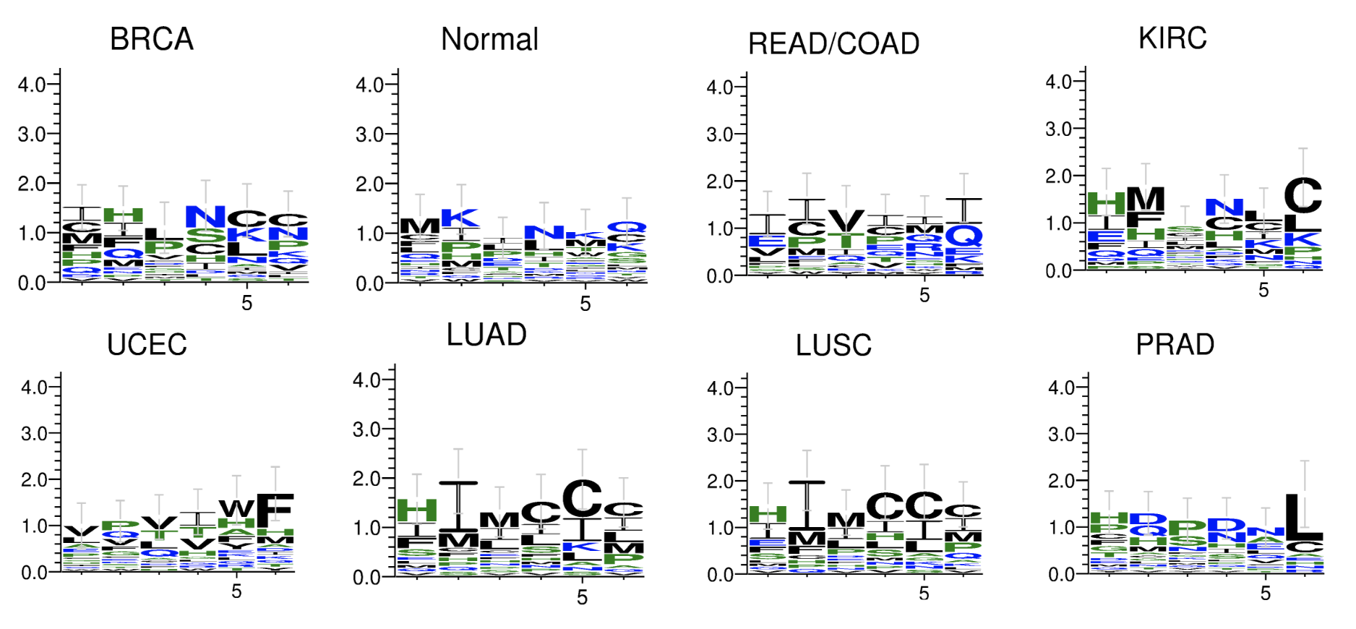
Results: Tumor-specific sequence logos
Notes:
A lot of diversity between cancer types
Not random: sequences that are conserved / significant for each tumor type
Interesting Note: LUAD and LUSC are very similar – expected, as they are both lung cancers

Slide 16
Clustering
Greedy similarity-based clustering
Notes:
For each tumor type, we cluster
Again, wanted to cluster b/c we know that in real life has >1 kmer sequence on the BCR that can bind to an antigen
We do clustering because we expect that there are multiple ”positive kmers” aka motifs
Methods: Use greedy clustering

Slide 17
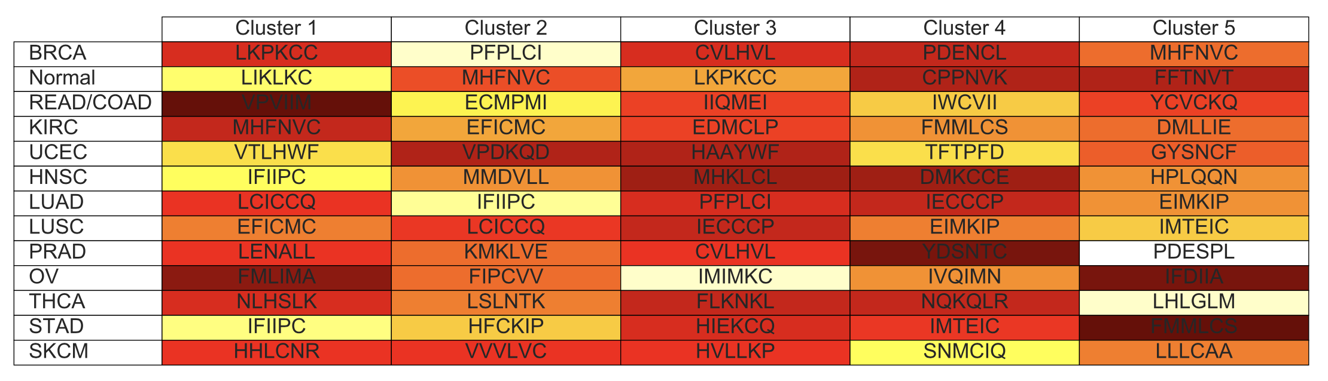
Identifying the significant 6-mer clusters for each tumor type
Each cluster’s ”lead k-mer” is shown
Tumor-specific
Notes:
Brighter colors = larger cluster size (more significance)
Most important results
As I’ll mention later, these have impact for cancer-specific drug development
Shown are the “leading kmers” or the kmers that defined the cluster

Slide 18
3. Comparison of models with different parameters
Correlation of cluster results
Training checkpoints
3D performance maps
Notes:
Wanted to validate our testing / clustering / extraction of motifs:
Validity check

Slide 19
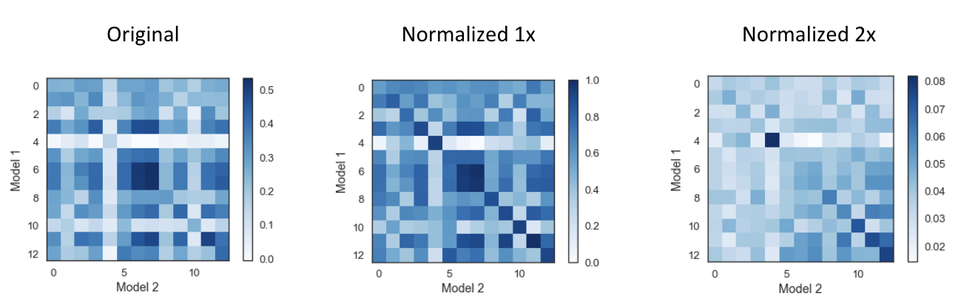
Correlation between two sets of model parameters
Correlation between tumor-specific results from 2 models with different training parameters
(300, 200, 1000, 500, 6, 20)
(300, 200, 1000, 1000, 6, 20)
Determining tumor-type specificity
Expect results for the same tumor type to be similar
Notes:
Wanted to see whether 2 models with slightly different training param had similar results
(500 -> 1000) kmers / patient
Top cluster results -> PWM -> vector
Was a significant similarity between the same cancer types
6 & 7 !!
Issues: clustering we had to switch into a build in algorithm instead of our own

Slide 20
Training checkpoints
Considered testing results at 5 different training checkpoints (100, 500, 1000, 2000, 3000)
Notes:
Further analysis

Slide 21
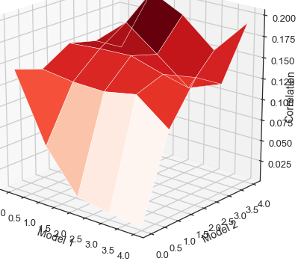
Model parameter trends are more similar after more training iterations
Similarity score
Model 1 iterations
Model 2 iterations

Slide 22
4. Further Analyses
Determining the location of the CDR3 binding motif

Slide 23
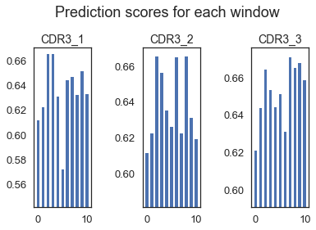
Methods: Visualizing binding affinity in CDR3 sequence positions
Used same-length CDR3s (ex: 16)
6-mer prediction scores -> binding scores at each CDR3 position
Sliding window method
Notes:
Only used CDR3s with length 16
Expect highest binding in the middle because that’s where the CDR3s are the most diverse

Slide 24
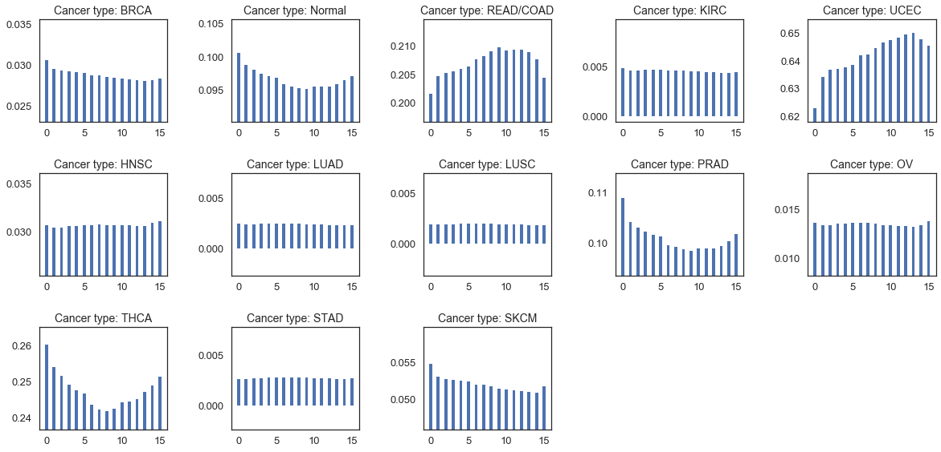
Average binding scores for the 16 CDR3 binding positions

Slide 25
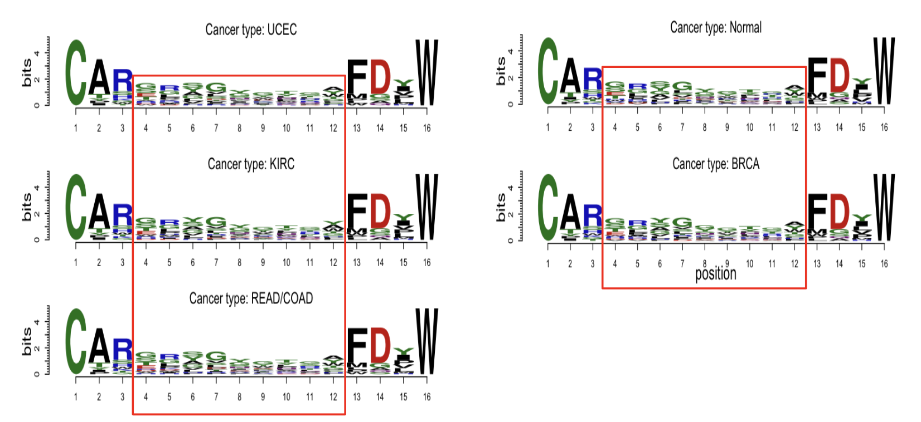
Cancer-specific CDR3 sequence logos
Notes:
Used the avg binding scores to “weigh” each CDR3 motif for each tumor type
The edges are conserved, but there is significant diversity in the middle area

Slide 26
Summary & Conclusion
Summary
Validation of DeepBCR model performance using synthetic data
Visualizing tumor-type-specific CDR3 binding motifs
Sequence logos
Clustering
Model comparison using cluster feature correlation
Determining the CDR3 binding location
Conclusion
Created robust method for identifying and visualizing tumor-specific BCR/CDR3 binding motifs
Validated methods using positive controls & model comparison
Notes:
Validation of DeepBCR model performance using synthetic data
Visualizing tumor-type-specific CDR3 binding motifs
Sequence logos
Clustering
Model comparison using cluster feature correlation
Determining the CDR3 binding location

Slide 27
Applications
Future Work
Predicting drug treatment responses
Monitoring disease prediction
AI/ML: Uncovering what the neural network learned
Refine model comparison analysis
Check 3D receptor structures
Antigen-specific CDR3 binding motifs
Design new antibody drugs for cancer treatments
Notes:
Applications
Monitoring disease prediction
Predicting drug treatment responses
AI: Uncovering what the neural network learned
Beyond the field of biology, my project has applications in the fields of AI and machine learning
There are many other ideas that I’d like to try
These are a few
Short term
Refine model comparison analysis
Increase number of training checkpoints
Get smoother 3d performance curve
Check 3D receptor structures
Long term
Antigen-specific CDR3 binding motifs
My project: tumor-specific
Each tumor has many related antigens
Go even more specific to antigens
Currently known antigens
Design new antibody drugs for cancer treatments
The ultimate goal
By modeling the interaction between B-cells and antigens, we are able to discover these important tumor-specific motifs
Thus, with this knowledge of which motifs are significant to each tumor type, we can design specific drugs and treatments for patients with a certain cancer type that will be more effective
End

Slide 28
Acknowledgments
Shirley Liu
Sherlock Hu
Immunology Group
The entire Liu Lab
Notes:
Shirley – internship opportunity, conduct such interesting work. High schooler
Sherlock – guiding me through project, answering questions, advice, tremendously helpful
Both provided ideas when I was stuck and my work would not have been possible without their continuous support and guidance.
Immunology group, especially the phds jin, jinxing, and rongbin providing company and allowing me to bounce ideas off of them
Finally: And the entire liu lab, dana farber, and Harvard medical school, for fostering such a great work and research environment and making my internship experience this summer in Boston so enjoyable
Thank you everyone

Slide 29
Thank you for listening! ☺
Any questions?

